Slide 1
Inverse Matrix
ZeroTechno

Slide 2
Introduction
An inverse matrix is a matrix that, when multiplied by the original matrix, results in the identity matrix.
This program is a C# Windows Forms Matrix Inverse Calculator that computes the inverse of a 3×3 matrix and solves linear equations using the inverse matrix method.
It allows users to input values (including fractions), checks if the matrix is invertible using the determinant, and prevents invalid calculations.

Slide 3
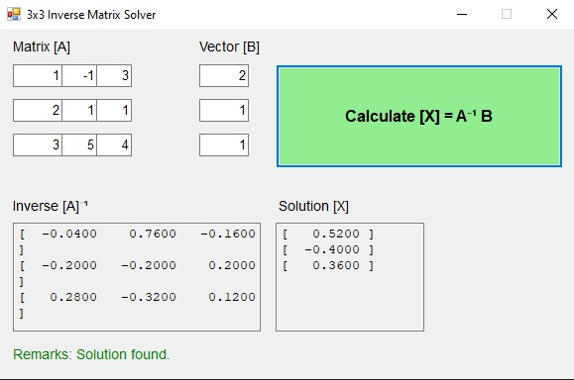
Full view of Program

Slide 4
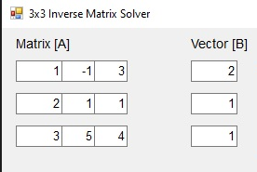
The process of the Program
The user first inputs the desired value within the matrix to turn into an inverse matrix. The program is capable of knowing that it’ll solve a 3x3 or a 2x2 matrix.

Slide 5
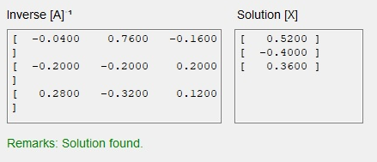
The process of the Program
The system then processes the values that were used by the user to then solve for an inverse matrix. If no inverse is found, it will tell the user with the text below. If however an inverse matrix was found, the result would be shown below.

Slide 6
End of Presentation

